Slide 1
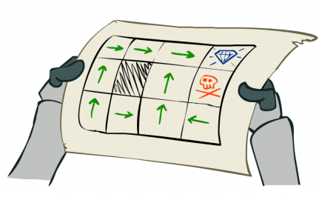
Markov Decision Process
Hongning Wang
CS@THU

Slide 2
Outline
Bellman equation
Optimal value function and optimal policy
Extensions of MDP

Slide 3

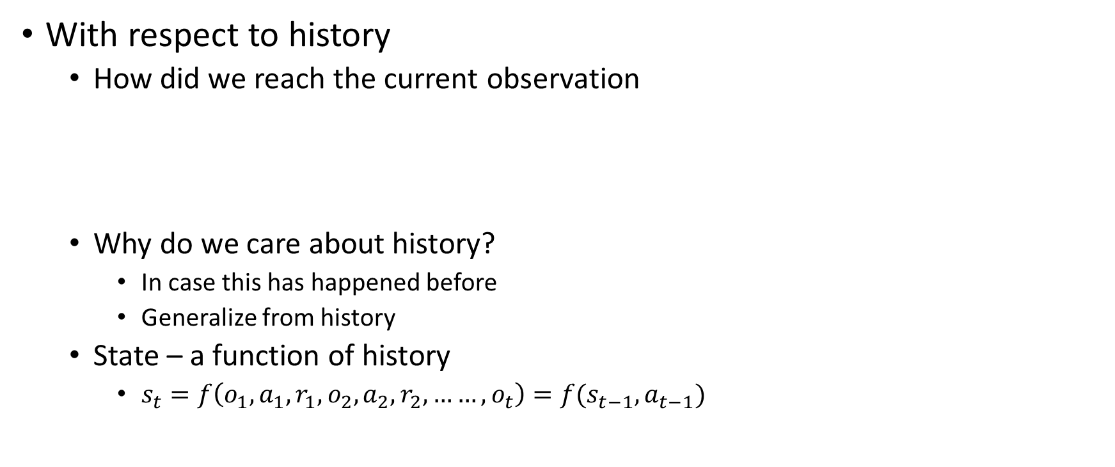
From the basics of RL
With respect to history
  How did we reach the current observation
  Why do we care about history?
    In case this has happened before
    Generalize from history
  State – a function of history
    $s_{t}=f\left(o_{1},a_{1},r_{1},o_{2},a_{2},r_{2},……,o_{t}\right)=f(s_{t−1},a_{t−1})$
$$o_{1},a_{1},r_{1},o_{2},a_{2},r_{2},……,o_{t},a_{t}$$
History
Assume Markovian states

Slide 4
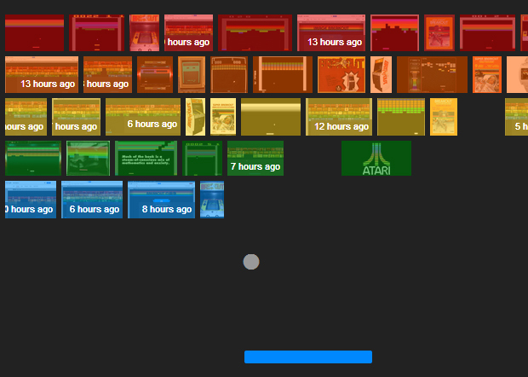
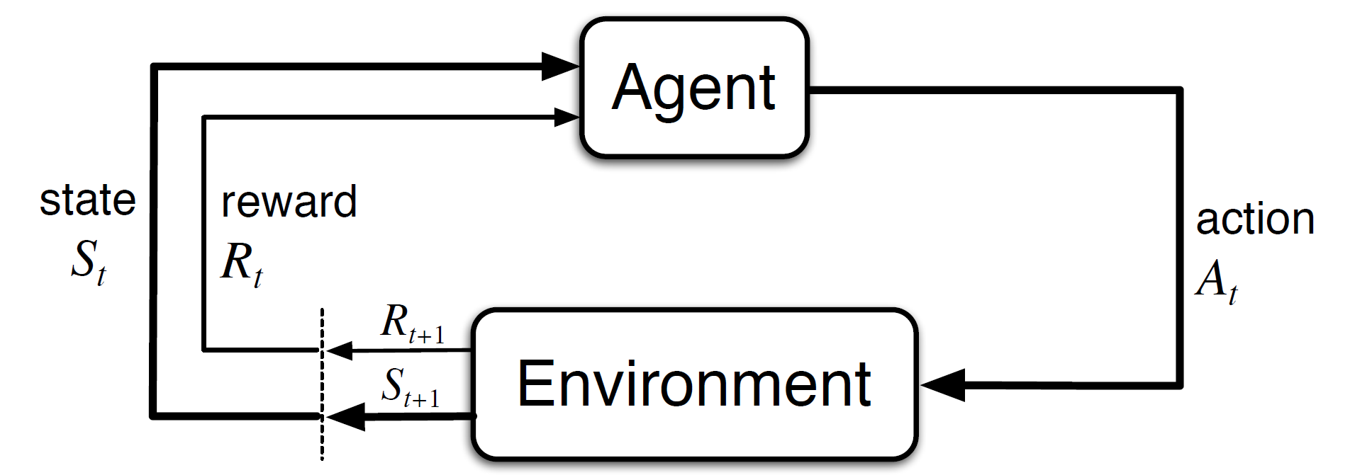
A typical illustration
State in the breakout game
State transition

Slide 5
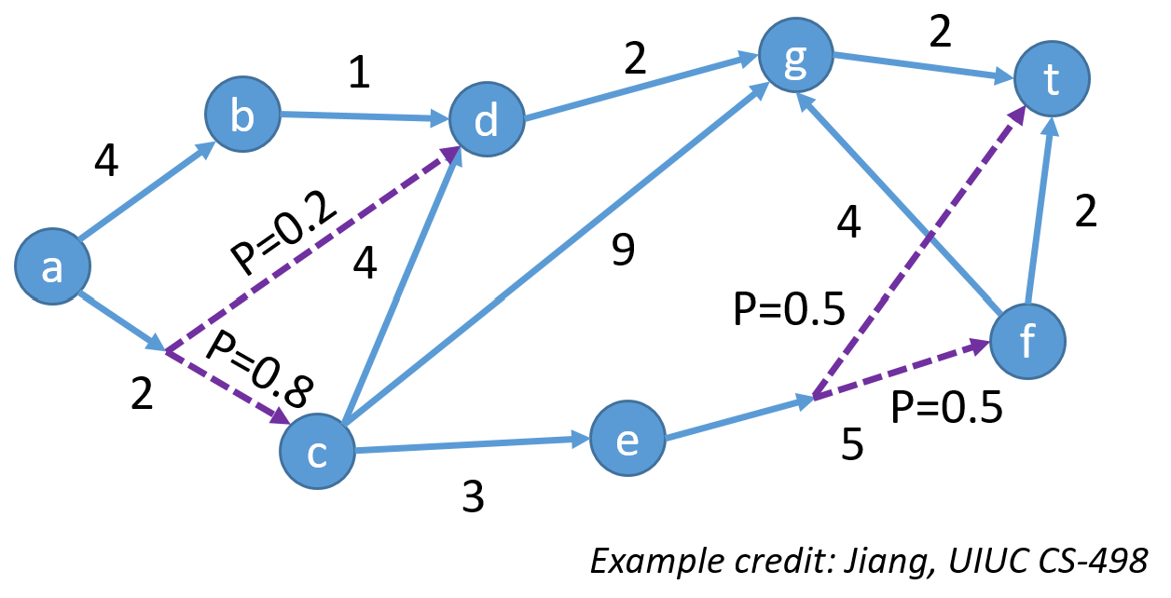

A toy example of MDP
State transition
$$p\left(s_{t+1}=′b′ | s_{t}=′a′, a_{t}=‘up’\right)=1.0$$
$$p\left(s_{t+1}=^{′}d′ | s_{t}=^{′}a′, a_{t}=‘down’\right)=0.2$$

Slide 6
A typical illustration
Expected reward for state-action pair

Slide 7

A toy example of MDP
Expected reward for state-action pair
$$r(s_{t}=^{′}a^{′},a_{t}=‘down’)=2.0$$

Slide 8
Agent vs., environment
Depends on the definition of action sets, i.e., the problem we are looking at
Where to draw the boundary?
  Is user interface a part of agent or environment in a recommender system?
  Is motor a part of agent or environment in a self-driving car?

Slide 9
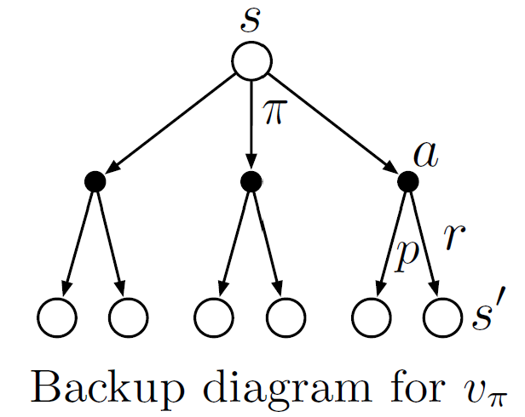
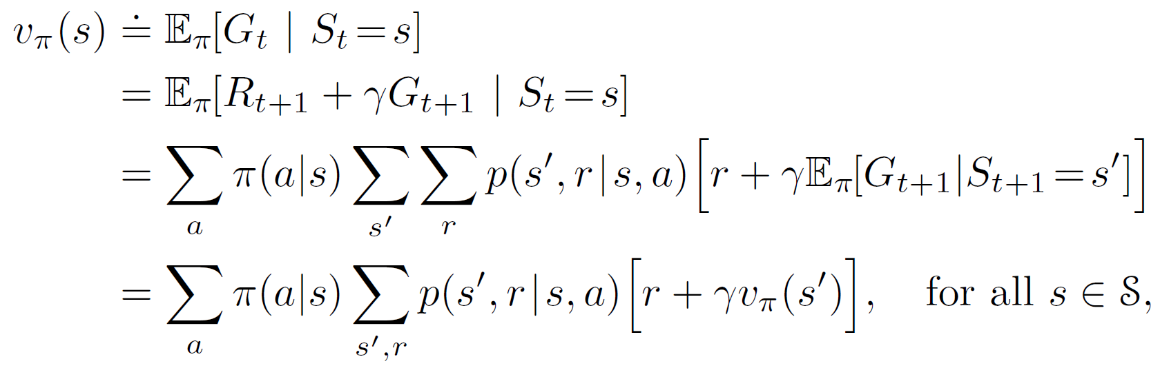
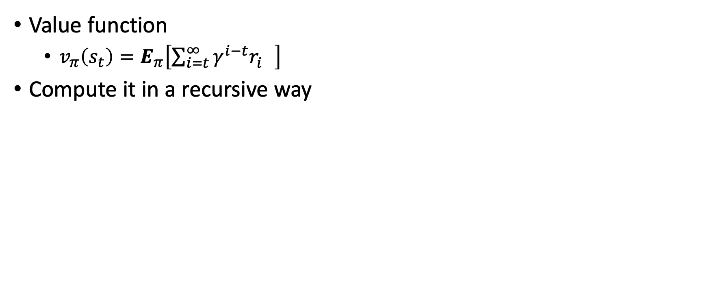


Bellman equation for value function
Can we compute an upper bound of it?
$$\frac{r_{max}}{1−γ}$$
Value function
  $v_{π}\left(s_{t}\right)=E_{π}\left[\sum_{i=t}^{∞}{γ^{i−t}r_{i}^{}}\right]$
Compute it in a recursive way
return
Unique solution of this equation
w.r.t a particular policy $π$

Slide 10
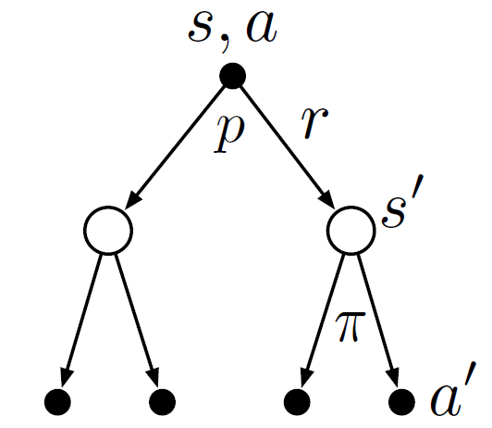
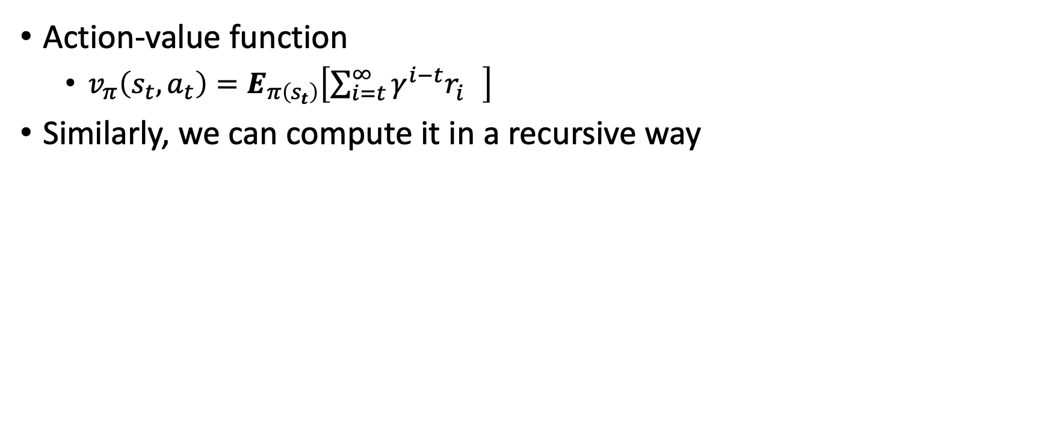
Bellman equation for value function
Action-value function
  $v_{π}\left(s_{t},a_{t}\right)=E_{π\left(s_{t}\right)}\left[\sum_{i=t}^{∞}{γ^{i−t}r_{i}^{}}\right]$
Similarly, we can compute it in a recursive way
$$q_{π}\left(s,a\right)=r+γ\sum_{s^{′}∈S}{p\left(s^{′} | s,a\right)}\sum_{a^{′}∈A}{π\left(a^{′} | s^{′}\right)}q_{π}(s^{′},a′)$$

Slide 11
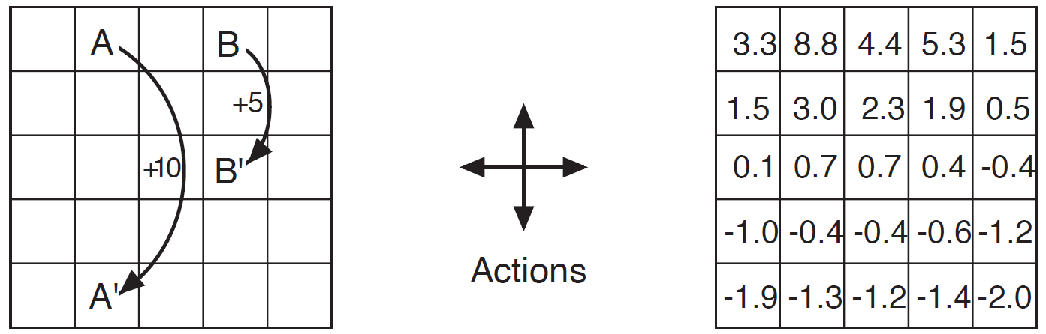
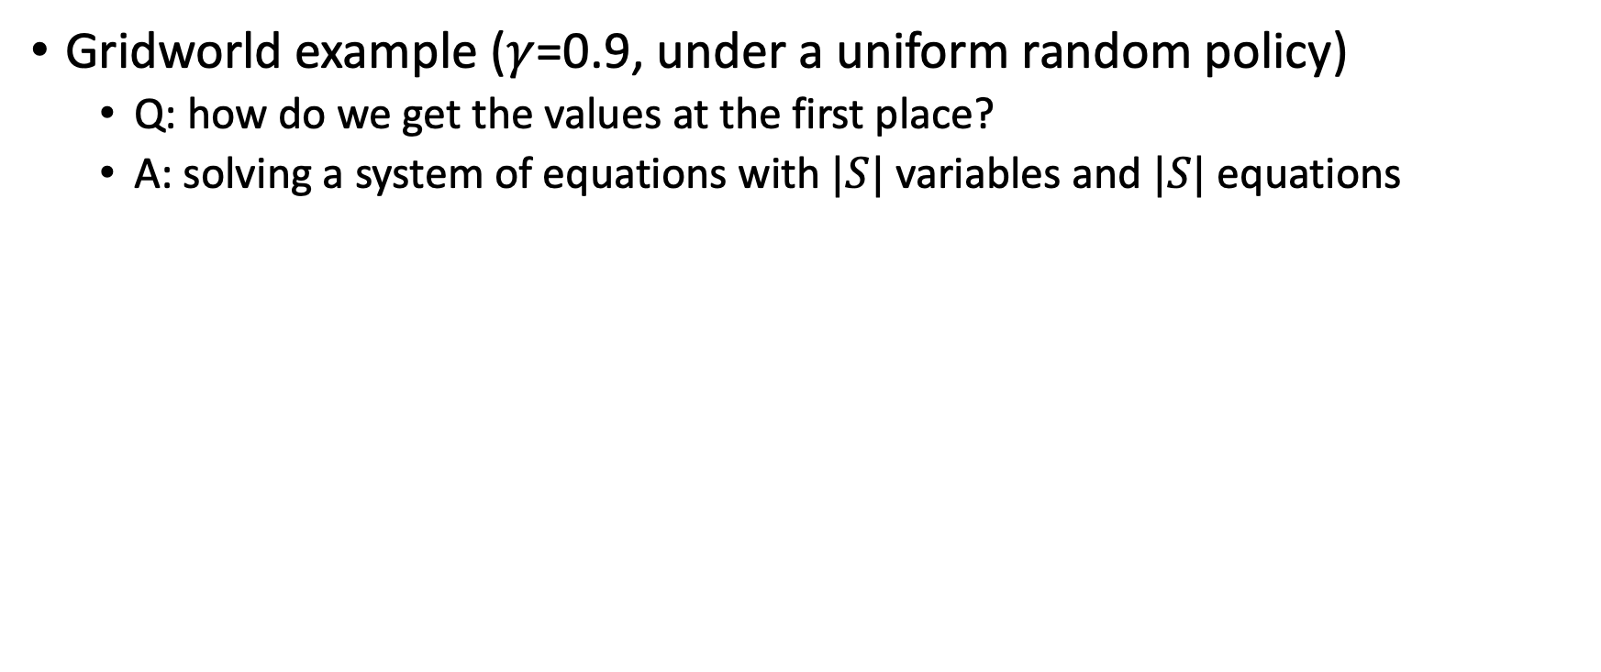
Bellman equation for value function
Gridworld example ($γ$=0.9, under a uniform random policy)
  Q: how do we get the values at the first place?
  A: solving a system of equations with $|S|$ variables and $|S|$ equations
$$0.25×\left(2.3+0.7−0.4+0.4\right)×0.9=0.675$$
A
B
$$v=0.25×[−1.2×0.9−1.4×0.9+\left(−1+0.9v\right)×2]$$

Slide 12


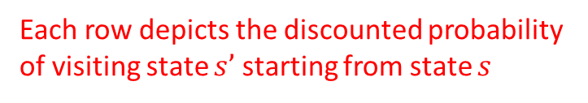
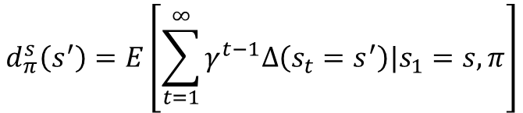
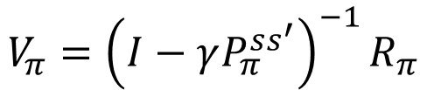

Bellman equation for value function
A closer look with a matrix form
$$v_{π}\left(s\right)=r\left(s,π\left(s\right)\right)+γp\left(s^{′} | s,π\left(s\right)\right)v_{π}(s′)$$
$$V_{π}=R_{π}+γP_{π}^{ss′}V_{π}$$
Complexity: $O({\left|S\right|}^{3})$
$$(I−γP_{π}^{ss′})V_{π}=R_{π}$$
State occupancy matrix
$$V_{π}={\left(I−γP_{π}^{ss^{′}}\right)}^{−1}R_{π}$$
$$d_{π}^{s}\left(s^{′}\right)=E\left[\sum_{t=1}^{∞}{γ^{t−1}Δ\left(s_{t}=s^{′}\right)|s_{1}=s,π}\right]$$
Proof of the solution’s existence and uniqueness?
Each row depicts the discounted probability of visiting state $s’$ starting from state $s$

Slide 13

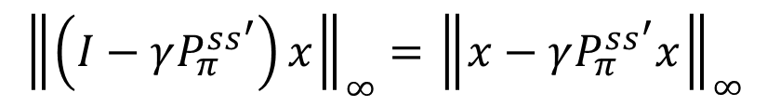
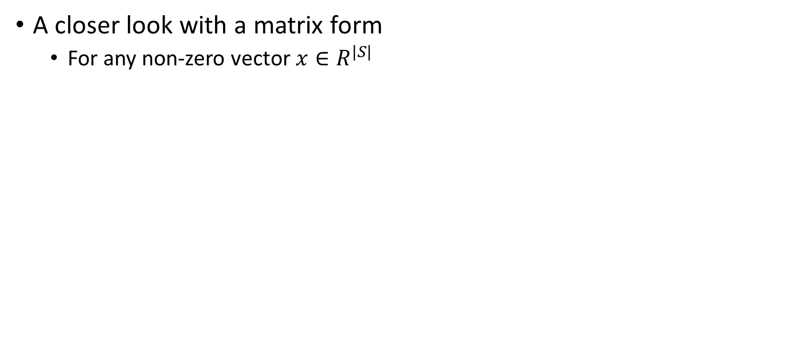

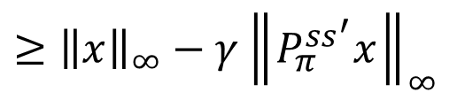
Bellman equation for value function
A closer look with a matrix form
  For any non-zero vector $x∈R^{|S|}$
$${\left\|\left(I−γP_{π}^{ss^{′}}\right)x\right\|}_{∞}={\left\|x−γP_{π}^{ss^{′}}x\right\|}_{∞}$$
$≥{\left\|x\right\|}_{∞}−γ{\left\|P_{π}^{ss^{′}}x\right\|}_{∞}$
$≥{\left\|x\right\|}_{∞}−γ{\left\|x\right\|}_{∞}>0$
$A$ is invertible if for any non-zero vector $x$, $Ax>0$

Slide 14
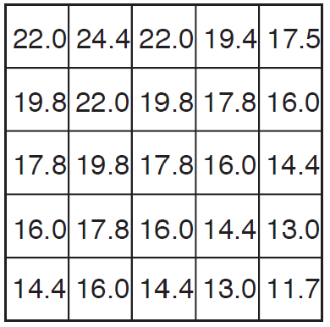
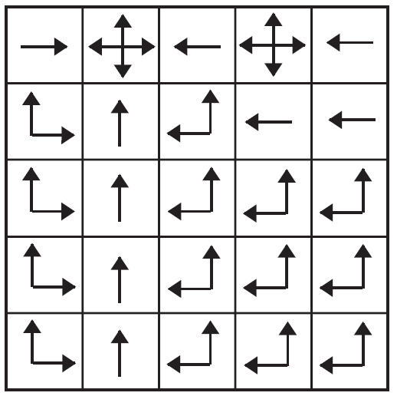


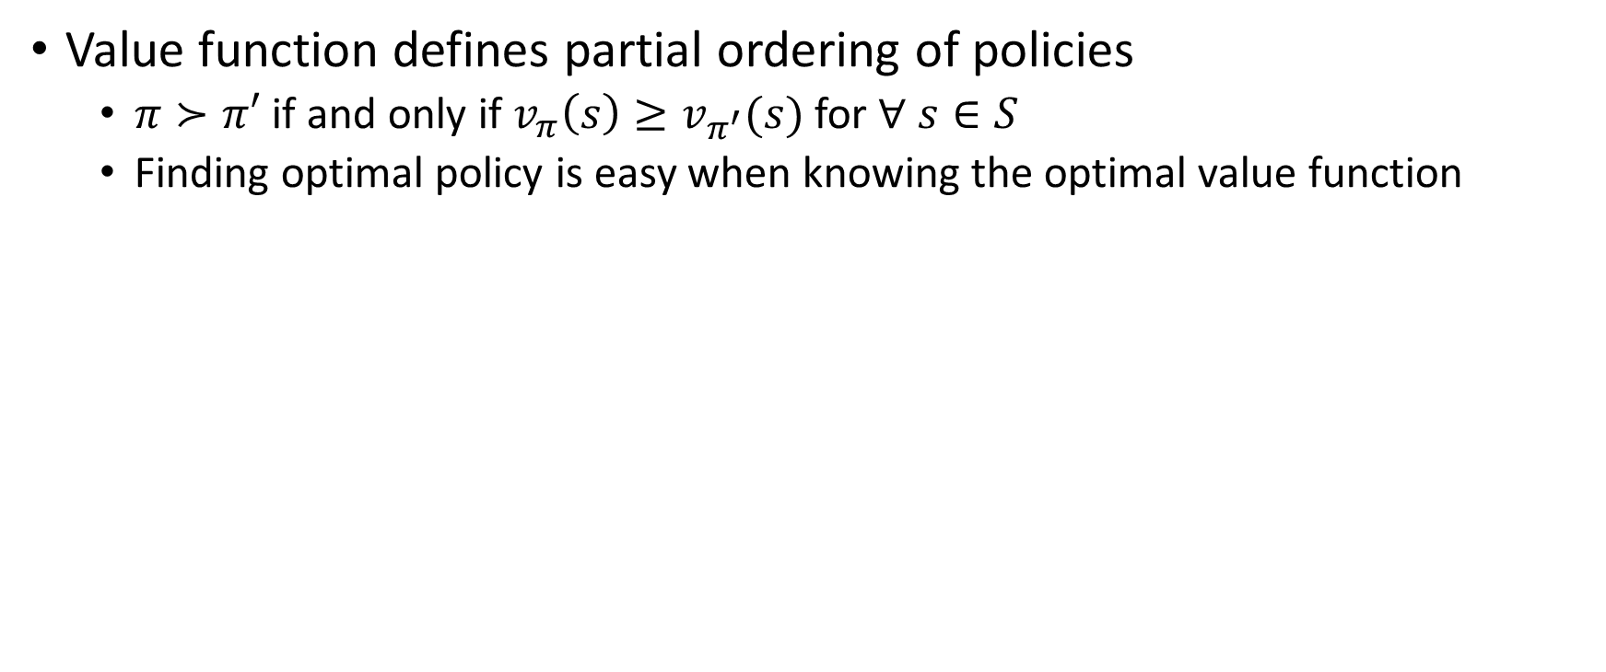




Optimal policy
How about Bellman’s equation?
Value function defines partial ordering of policies
  $π≻π′$ if and only if $v_{π}\left(s\right)≥v_{π^{′}}(s)$ for $∀ s∈S$
  Finding optimal policy is easy when knowing the optimal value function
$$v_{rnd}$$
$$v^{∗}$$
$$π^{∗}$$
$$17.8=19.8×0.9$$
If we increase the reward of all state action pairs by a constant c, how would it affect an agent’s behavior?
$$16.0=17.8×0.9×0.5×2$$

Slide 15
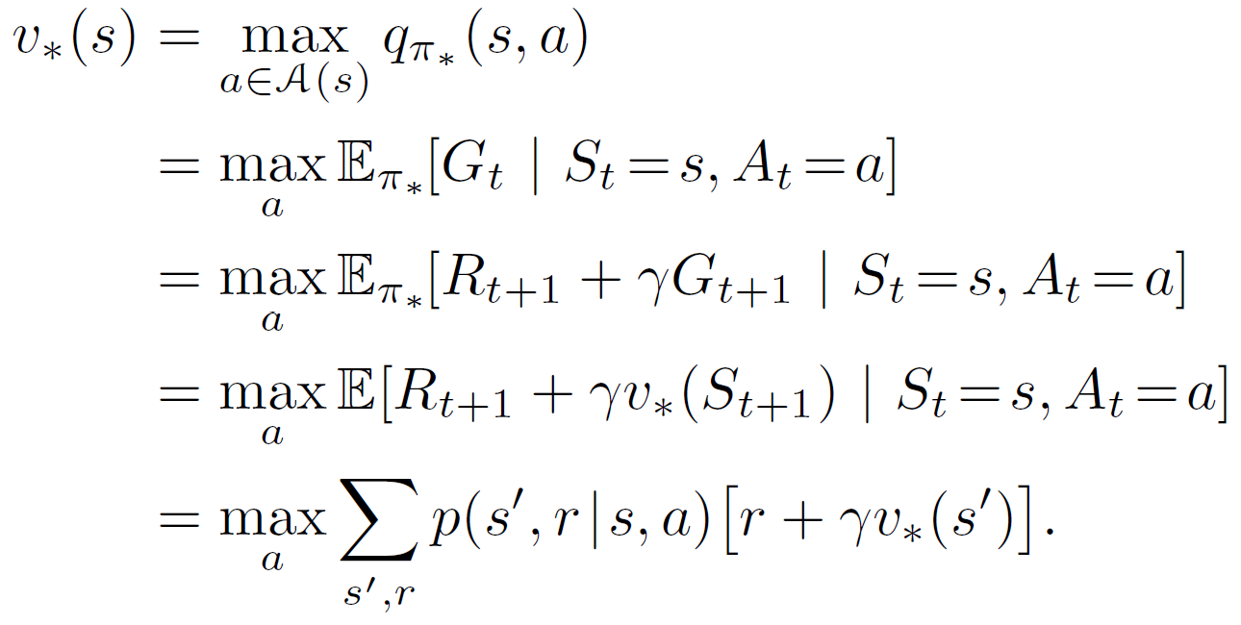
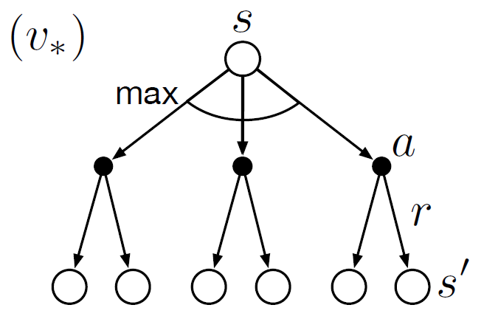
Bellman equation for optimal value function
It still holds (and of course!), but in a special form
Optimal value induced policy
Optimal policy’s action-value function
A.k.a Bellman optimality equation
Obtained by optimal policy: optimal value is achieved by the best action under each state

Slide 16
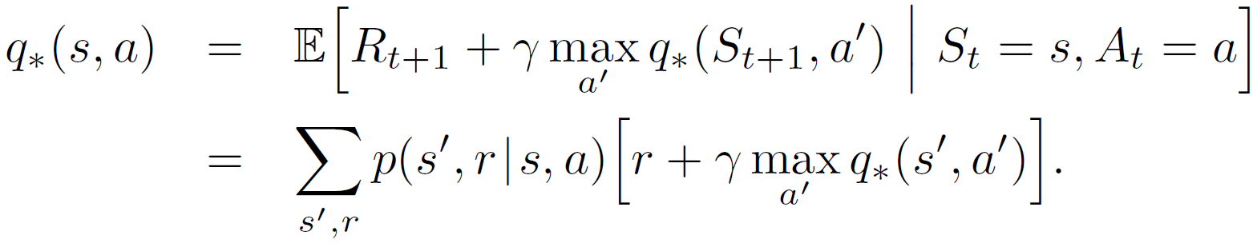
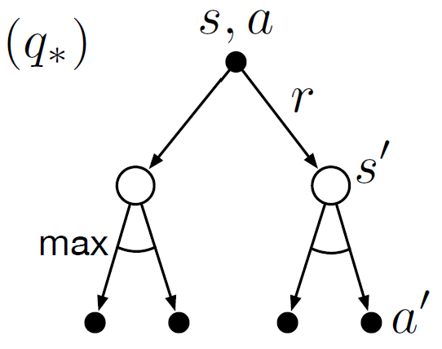
Bellman equation for optimal action-value function
It is also in a similar and special form
No closed form solution!
Q: How do we really find it?
A: Solving a set of system equations, one equation for each state-action pair!
Requirements:
Known environment dynamics
Markovian states
Abundant computational power
Otherwise, we will approximate it!

Slide 17
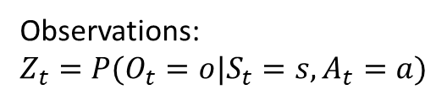
Extensions of MDP
Partially Observable Markov Decision Process (POMDP)
  Markov process vs., hidden Markov process?
  Now the agent needs to infer the posterior of states based on history, the so-called belief state
Observations:
$$Z_{t}=P(O_{t}=o|S_{t}=s,A_{t}=a)$$

Slide 18
Extensions of MDP
Fixed horizon MDP
  Predefined length of interactions
Continuous state/action space
  Make it functional, e.g., a linear or quadratic model
Continuous time
  Partial differential equations
Ergodic MDP
  The underlying Markov process is ergodic
  Stationary distribution exists, which makes the calculation of value function easy

Slide 19
Takeaways
Markovian states lead to Bellman expectation equation and optimality equation for MDPs
Both of them result in a system of equations which has a unique solution

Slide 20
Suggested readings
Chapter 3, Finite Markov Decision Processes

